Slide 1
LinZ Geo QuiZ
2nd June 2017
Breitenfellner Marcel
Obermayr Christian
Punz Jürgen
Arora Ravdeep

Slide 2
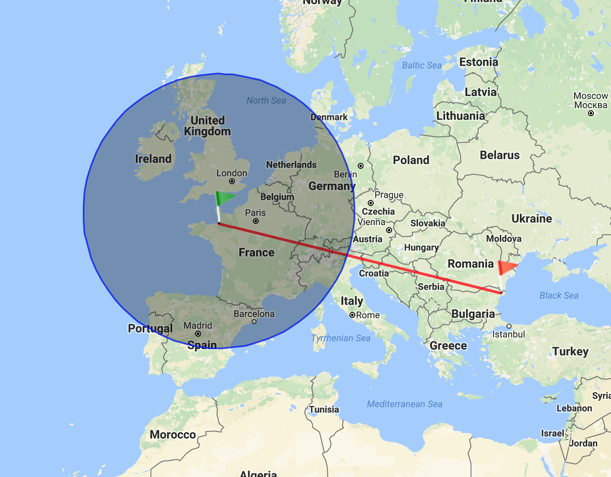
Idea
Geo Quiz for Linz
Displays Distance
Categories
Streets
Hospitals
...
Improve Geographical Skills
Possible Target Audience
Taxidriver
Police

Slide 3


(Planned) Features
Quiz Categories
Timed Games
Open Data (data.gv.at osm.org)
Record Statistics
Facebook Login (OAuth2)
Facebook Sharing
Android Version
iOS Version
(optional) Windows Phone Version

Slide 4
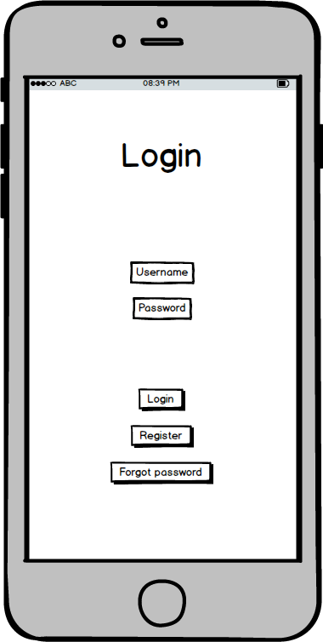
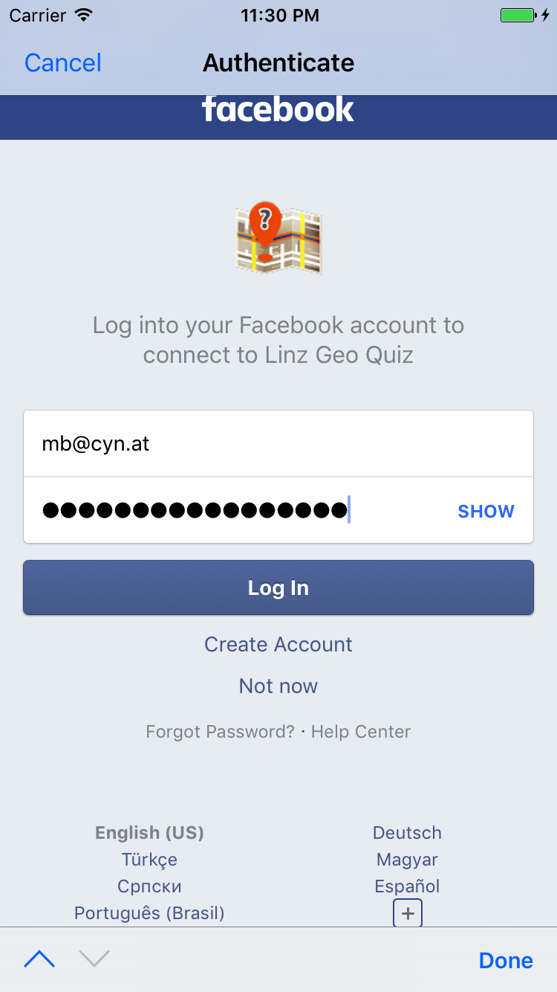
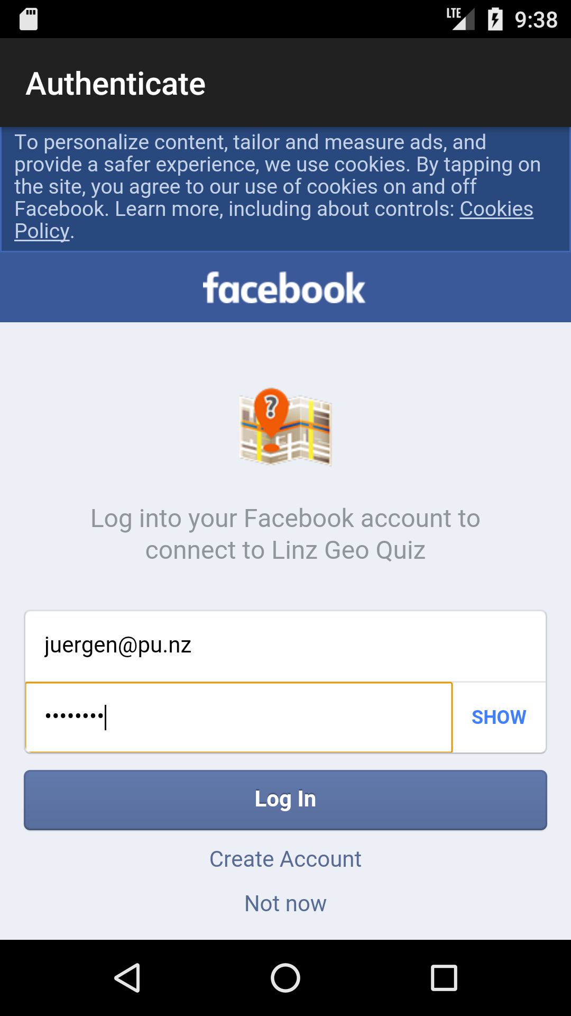
Design vs. Implementation
Mockup
iOS App
Android App

Slide 5
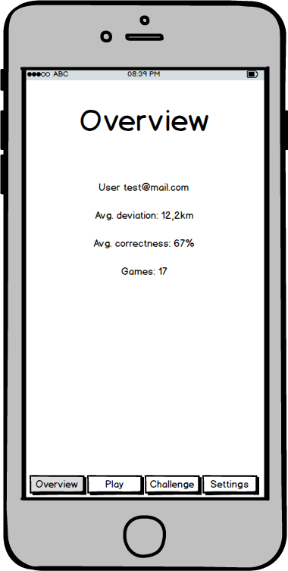
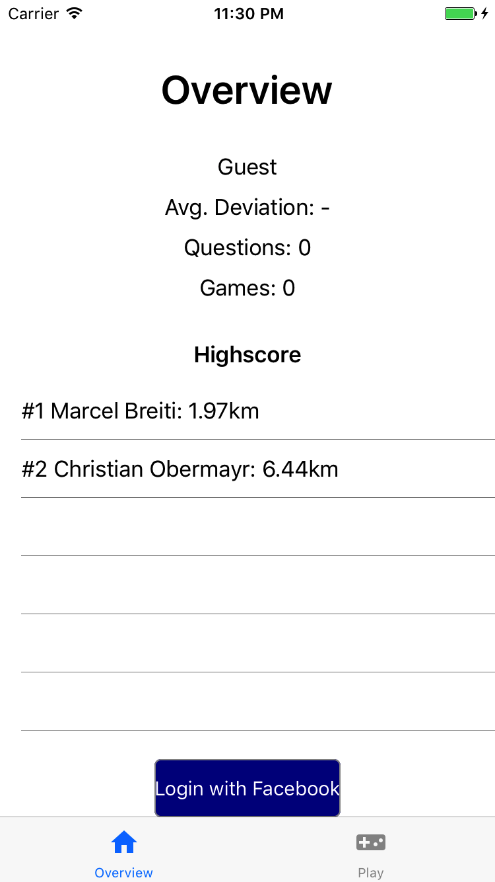
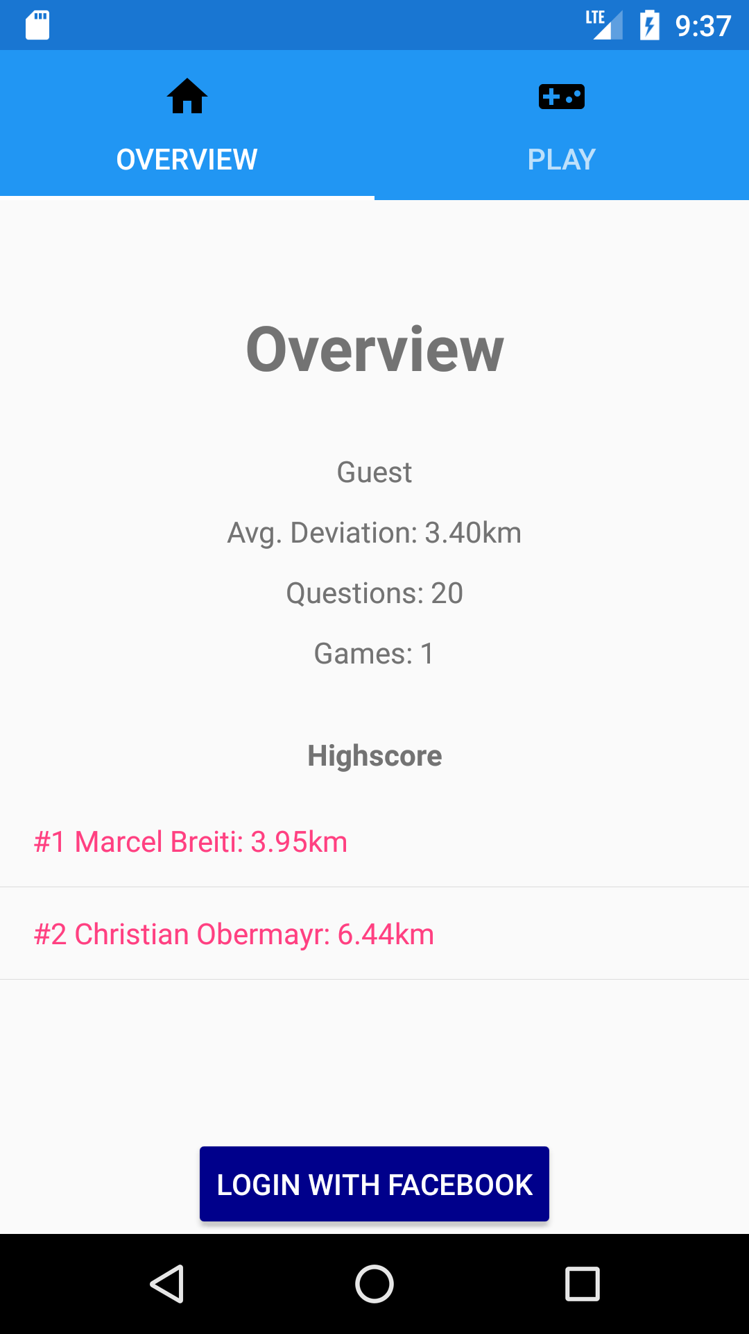
Design vs. Implementation
Mockup
iOS App
Android App

Slide 6
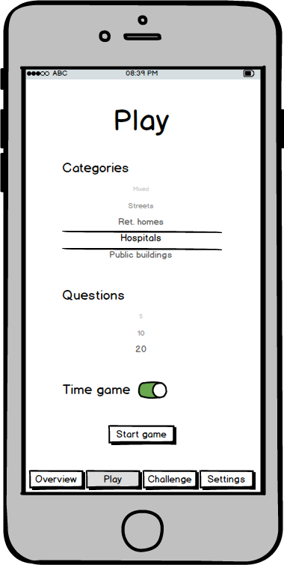
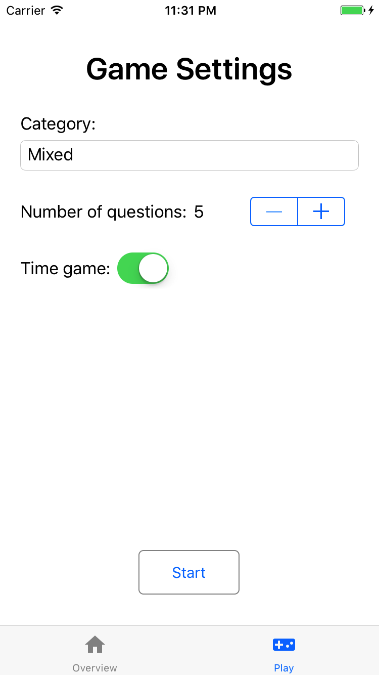
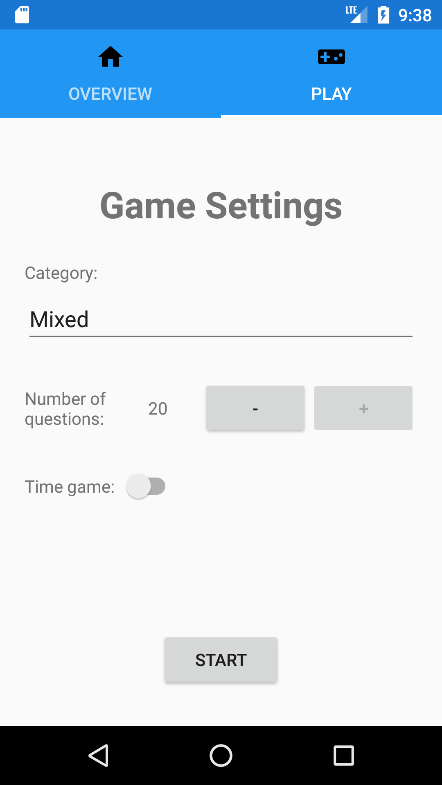
Design vs. Implementation
Mockup
iOS App
Android App

Slide 7
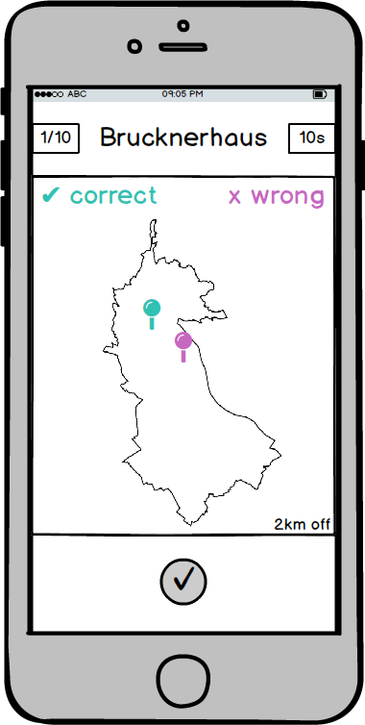
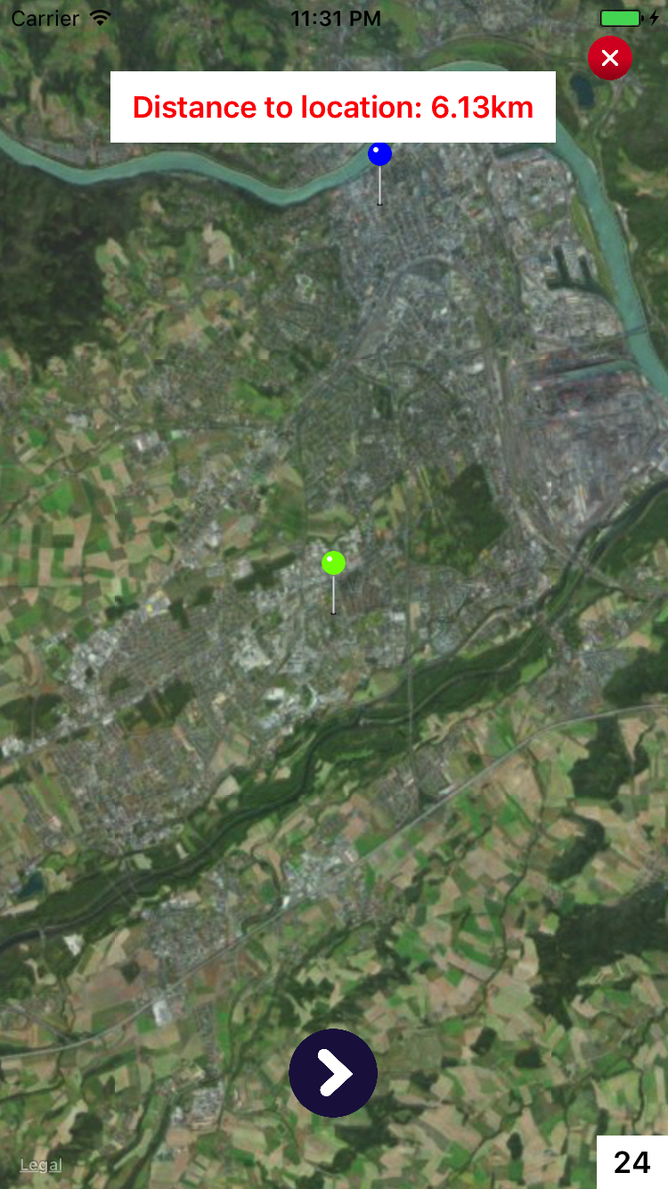
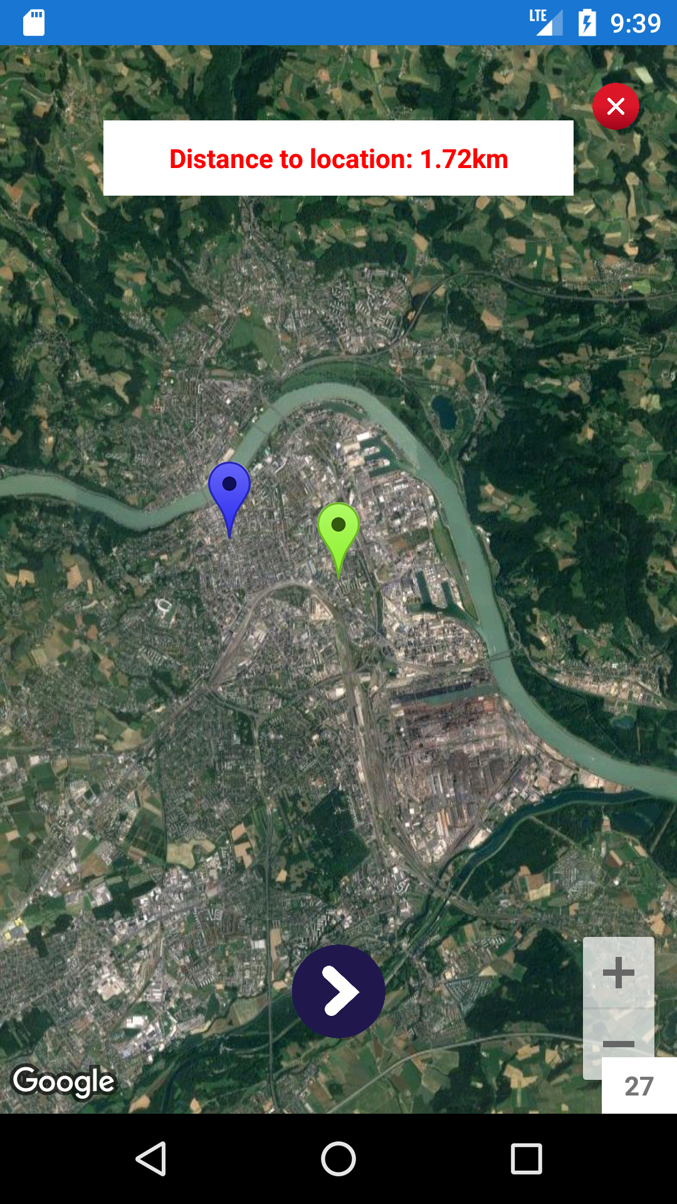
Design vs. Implementation
Mockup
iOS App
Android App

Slide 8
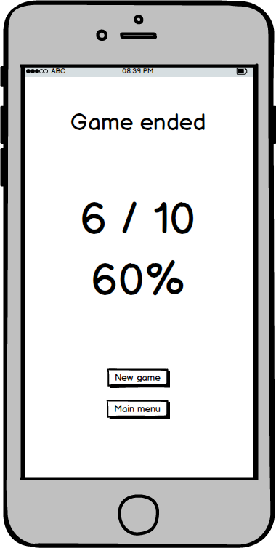
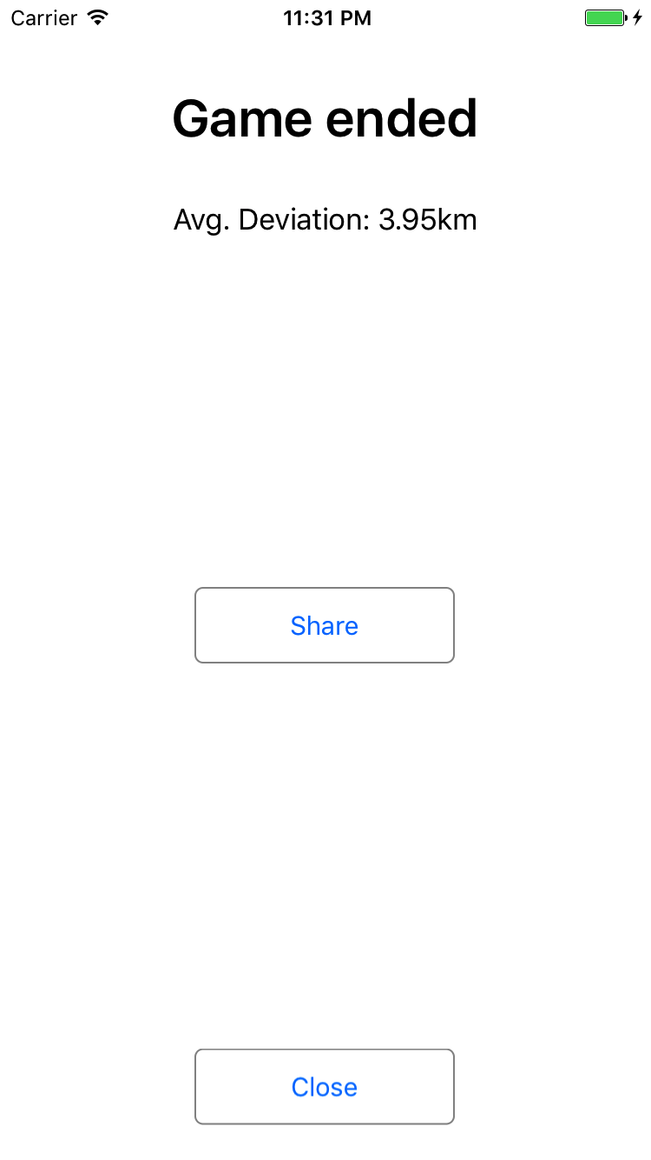
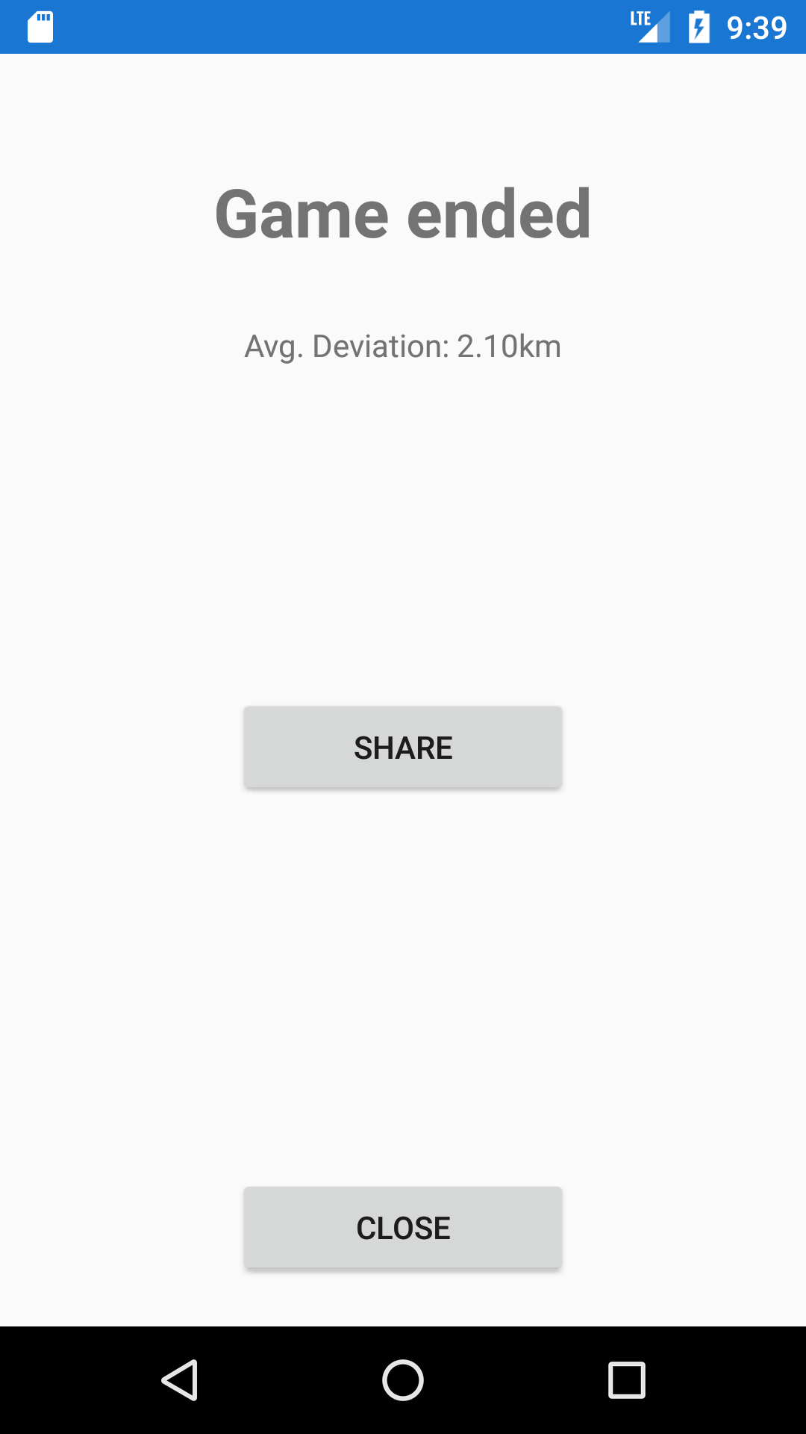
Design vs. Implementation
Mockup
iOS App
Android App

Slide 9
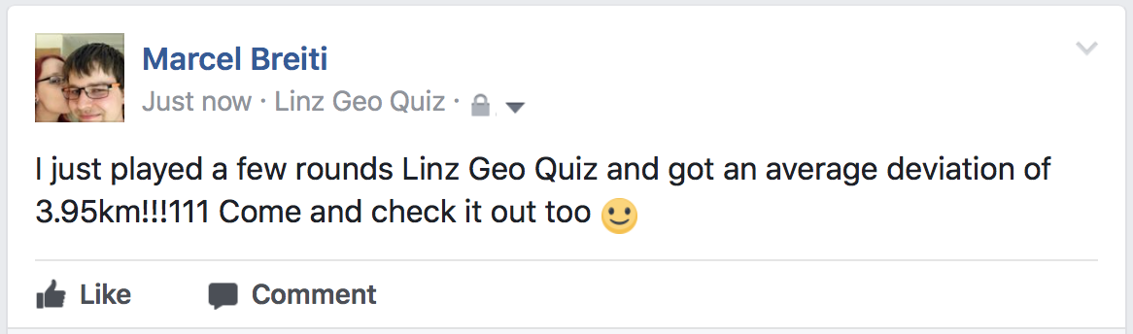
Design vs. Implementation

Slide 10
Project Architecture

Slide 11
System Architecture

Slide 12

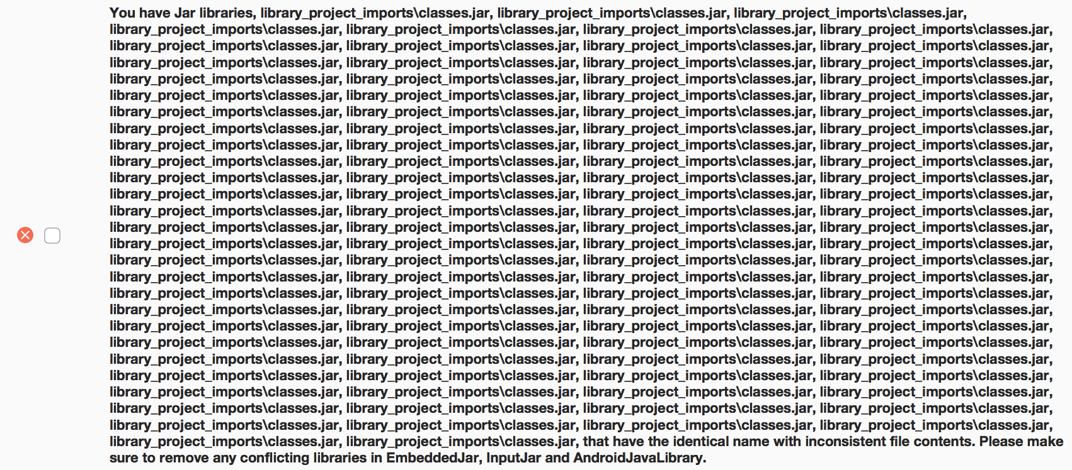
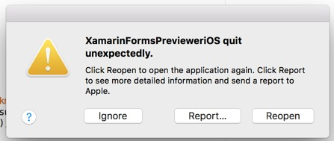
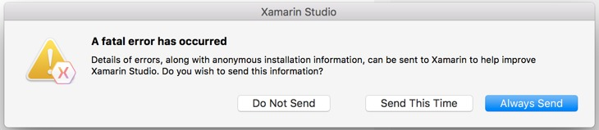
Can‘t compile for Android on macOS
Can‘t set app icon on iOS
No local key/value storage
Hardly any usable third-party stuff (e.g. Facebook SDK)
32bit apps per default
Unstable IDE

Slide 13

Developing with Xamarin be like..
"vong usability 1 scheiß" – Ing. Jürgen Punz, BSc, 2017

Slide 14
Poster?

Slide 15
Live Demo

